Slide 1
eResearch and HPC Education in New Zealand
Jaison Mulerikkal (NeSI, Auckland)
Stuart Charters (Lincoln University)

Slide 2
Why talk about Education?
One of the three themes of eResearch 2014.
Tool to take full advantage of existing high performance computing (HPC) technologies.
If not, run the risk of doomed to our PCs, whereas the rest of the world may outpace us with the speed and scale that HPC provides.

Slide 3
Education & Training Offerings
Universities
eResearch Organisations
Discipline Specific Course
HPC Qualifications
Research Projects
Workshops
Short Courses
One-on-One
Online Materials
Summer & Winter Schools
Student Internships

Slide 4
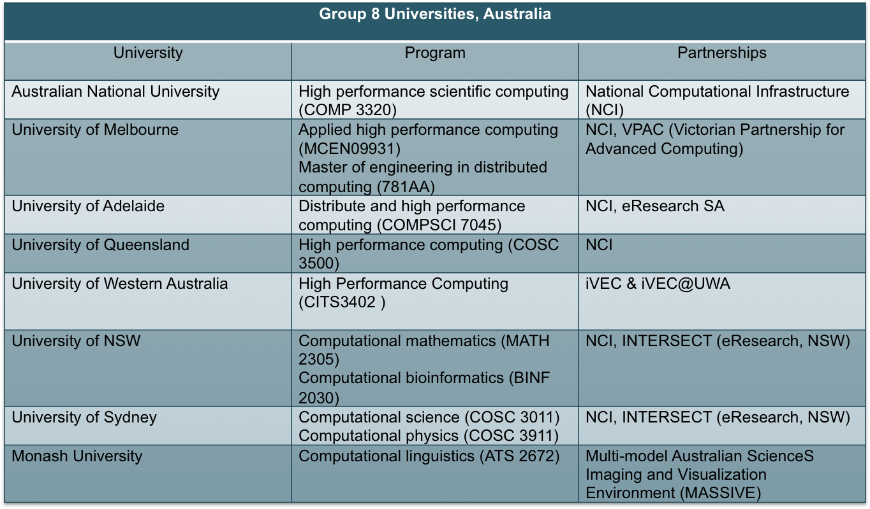
Offerings @ G8 Australian Unis

Slide 5
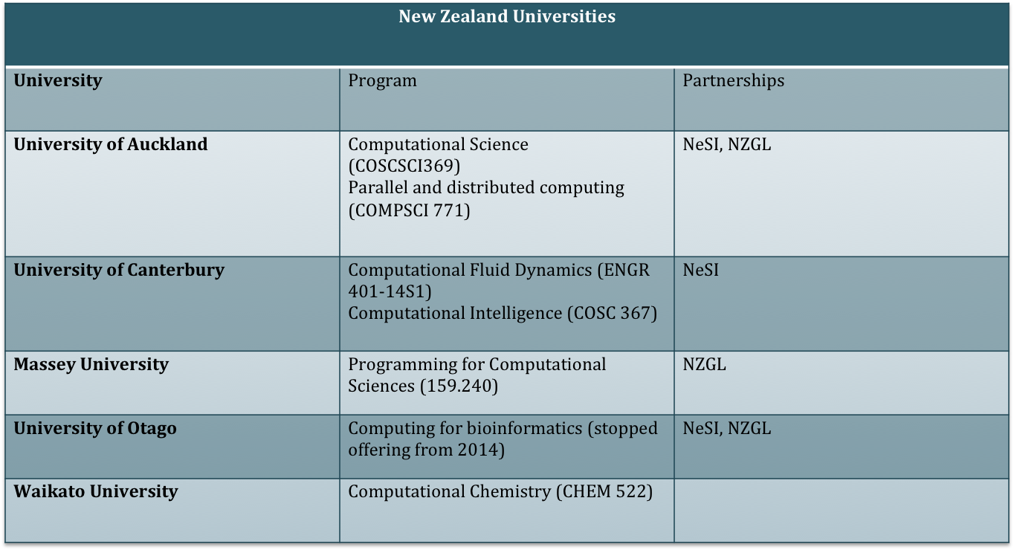
Offerings @ NZ Unis

Slide 6
Observations
NZ lacks core HPC/eResearch education opportunities (compared to Australia).
  “My impression is that Computer Science is currently problematically devoid of practical HPC teaching.” David Eyers, UoO
% of respondents say they need more HPC training offers in NZ:
  NeSI Newsletter survey: More than 80%
  University of Otago feedback: 100%

Slide 7
Challenges in NZ
Small Population – Students and Researchers
Training current generation
Upskilling future generations
Limited resources
Wide range of needs

Slide 8
Future Direction
No one university or organisation can go alone.
  Not enough critical mass
Partnerships.
  Between universities
  With eResearch organizations (like NeSI, NZGL, BlueFern, NIWA)
Leverage International Community.

Slide 9
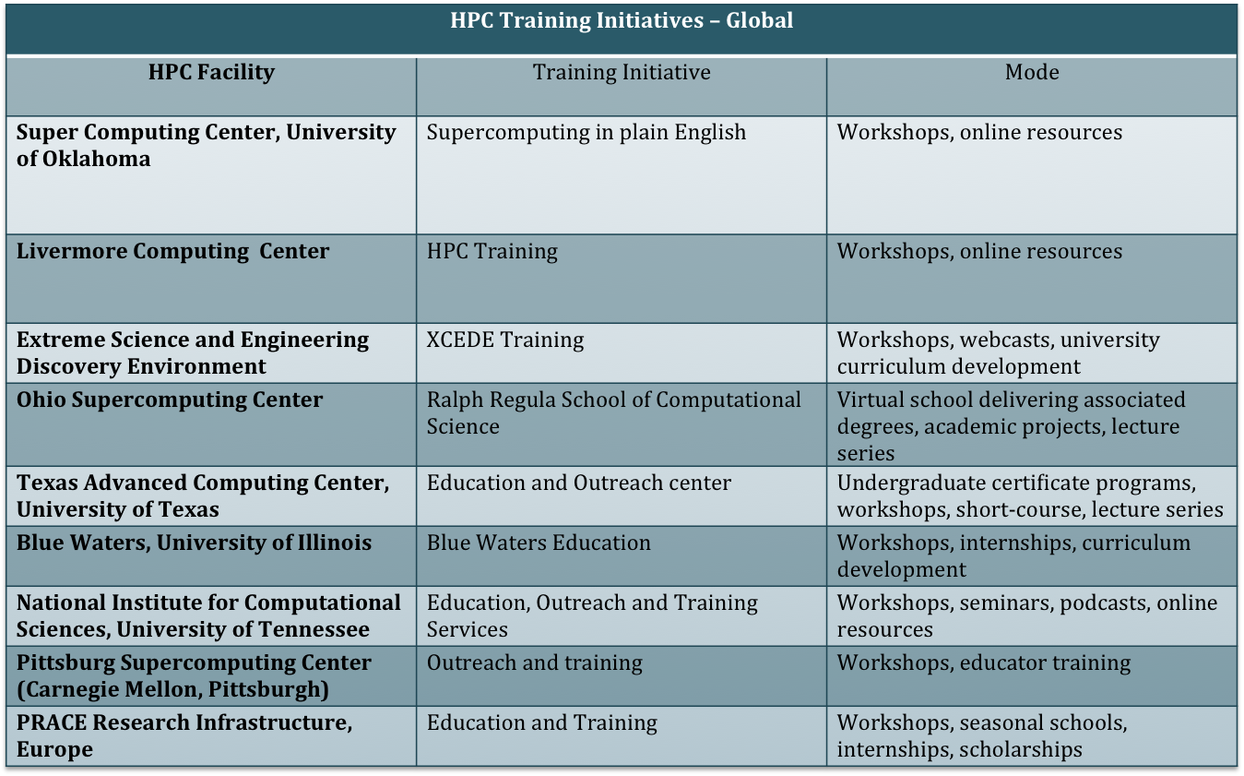
Initiatives @ Global HPC Centers

Slide 10
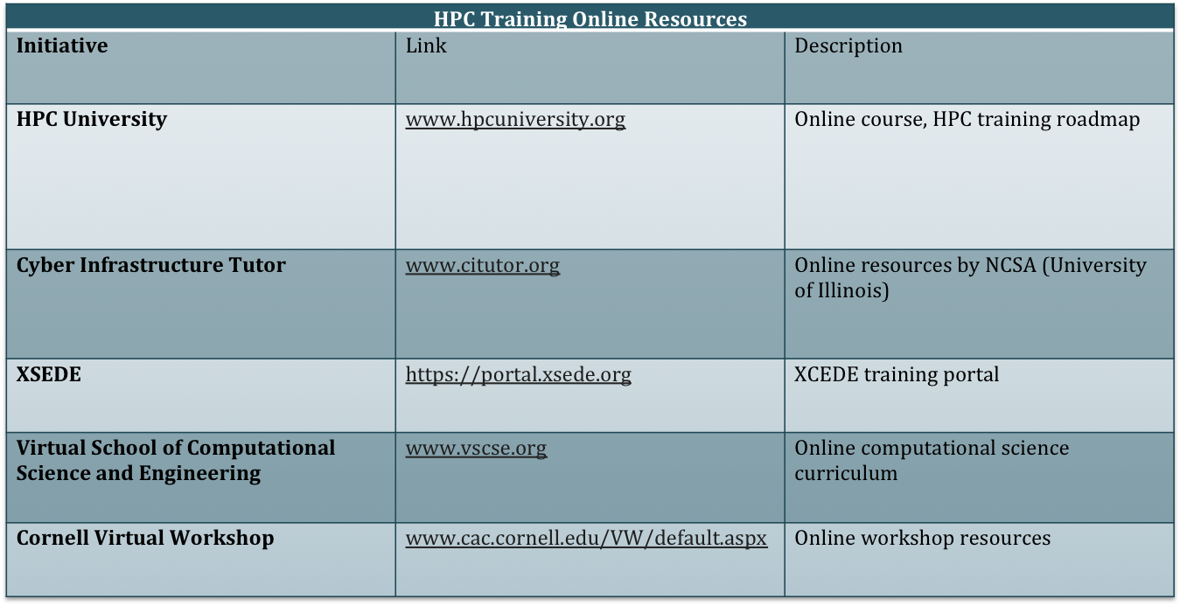
Online Initiatives

Slide 11
Case Study:
Supercomputing in Plain English
Initiative of Oklahoma University (OU) Supercomputing center for Education and Research (Director: Henry Neeman).
Offerings
  Workshops
    Software Carpentry boot camps
    Summer schools
    External outreach workshops
  Symposiums
  Online resources (www.oscer.ou.edu)

Slide 12
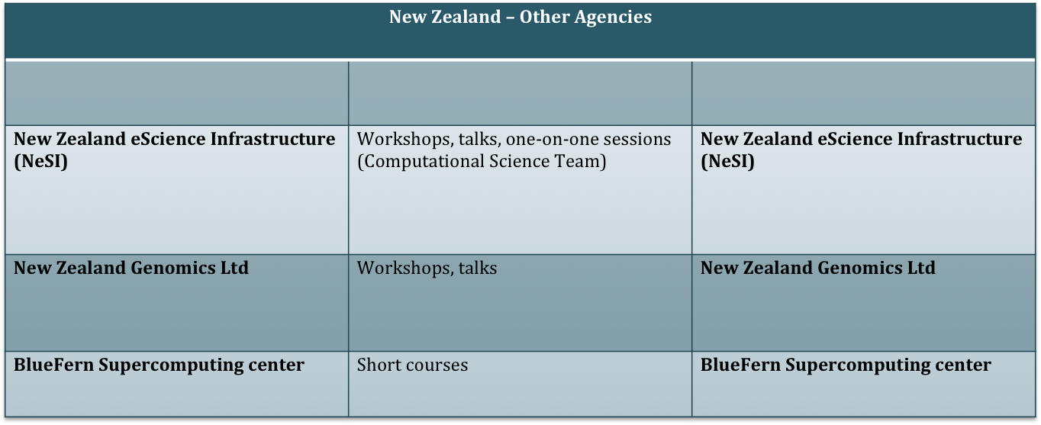
NZ eResearch Agencies

Slide 13
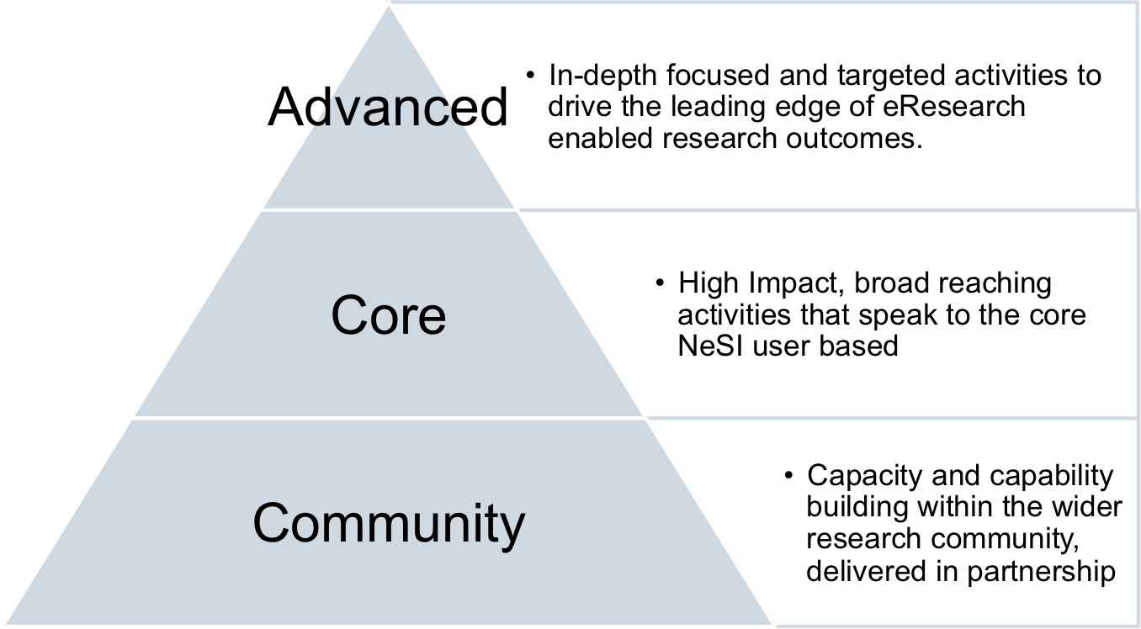
Classification

Slide 14
Core & Advanced
Discipline Focussed Workshops
Common Technologies
Scripting
MPI/OpenMP Programming
Advanced & Niche Technology training
One-on-one tutorials
Advanced debugging & profiling.

Slide 15
Community
Software carpentry
HPC User Group
NeSI Ambassador's Network
Academic Education Support
  Curriculum development
  Educator workshops

Slide 16
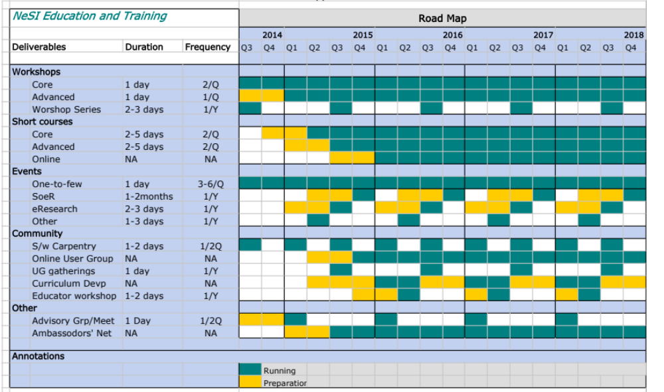
A Possible NeSI E&T Roadmap

